Slide 1

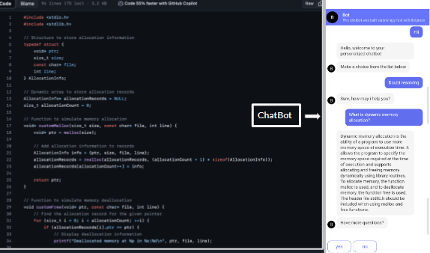
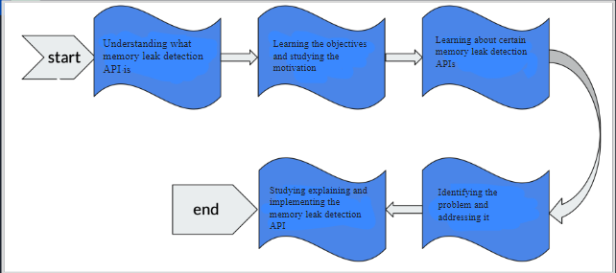
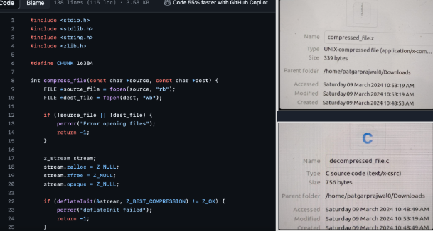
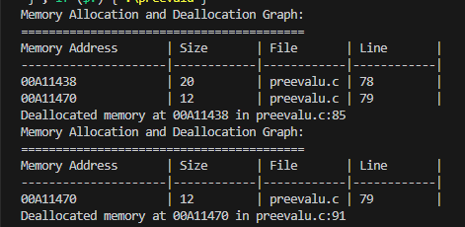
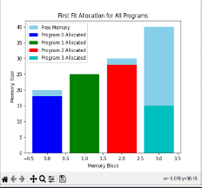
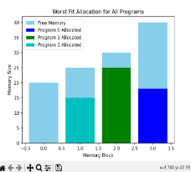
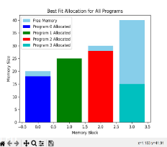
RV College of Engineering
R V College of Engineering
Go, change the world
Memory Consumption Profiling and compression system
Nischint Tiku (1RV22CS131) , Pratham CHIB (1RV22CS146),Nayana prakash Naik(1RV22CS126)
Department of Computer Science and Engineering
RV College of Engineering, Bangalore – 560059, INDIA
Introduction:
1. A memory leak detection system is a tool or set of tools designed to identify and report instances of memory leaks in software applications.
2.A memory leak occurs when a program allocates memory but fails to release it properly, leading to a gradual consumption of system resources and potential degradation of performance. Memory leaks can be a significant issue in long-running applications, as they can cause the program to use more and more memory over time, eventually leading to crashes or slowdowns.
Methodology:
Discription about our project:
1.CHAT BOT
We have created a chat-bot to answer all the queries related to memory profiling and dynamic memory allocation for a new exposed netizen in coding to understand the importance of memory management in OS
2. PYCHARM SIMULATIONS on Dynamic Storage Allocation Solution
The multiple partitioning method in OS is used for memory allocation to allocate blocks of memory available optimising the memory.Gives simulation on paging and virtual memory concepts- best fit, worst fit, first fit
First fit: Allocate the first hole that is big enough.
Best fit: Allocate the smallest hole that is big enough.
Worst fit. Allocate the largest hole.
3. C CODE
Writes C commands on memory allocation-deallocation and compression.
Results:
Conclusion:
In conclusion, memory profiling is an invaluable technique for analyzing and optimizing memory consumption, detecting memory leaks, and implementing compression strategies. By systematically monitoring and analyzing the memory usage of an application,we can identify areas of inefficiency, pinpoint memory leaks, and device strategies to reduce memory footprint.
References:
Ling Yuan , Siyuan Zhou, Peng Pan and Zhenjiang Wang,MLD: An Intelligent Memory Leak Detection Scheme Based on Defect Modes in Software,Department of Computer Science, Huazhong University of Science and Technology, Wuhan 430074, China,2020
Dilip KumarGangwar,Avita Katal, MemoryLeak Detection Tools:A Comparative Analysis, Information, Communication & Technology (RTEICT), August 27th & 28th 2021
Anshul Jindal1 , Paul Staab2 , Pooja Kulkarni1 , Jorge Cardoso2 , Michael Gerndt1 and Vladimir Podolskiy,Memory Leak Detection Algorithms in the Cloud-based Infrastructure, Research Center, Huawei Technologies Munich, Germany,
Sigmund Cherem, ,Lonnie Princehouse ,Radu Rugina,Practical Memory Leak Detection using Guarded Value-Flow Analysis,National Science Foundation grant CCF-0541217 and AFOSR grant FA9550-06-1-0244., 2022
Submitted to
Submitted by
Dr.Jyoti Shetty
Assistance Professor
Department of Computer Science
RVCE
Nischint Tiku (1RV22CS131) ,Pratham CHIB(1RV22CS146),Nayana Prakash Naik(1RV22CS126)

